Slide 1
We work to ensure that every pregnancy is wanted, every child birth is safe and every young persons’ potential is fulfilled

Slide 2
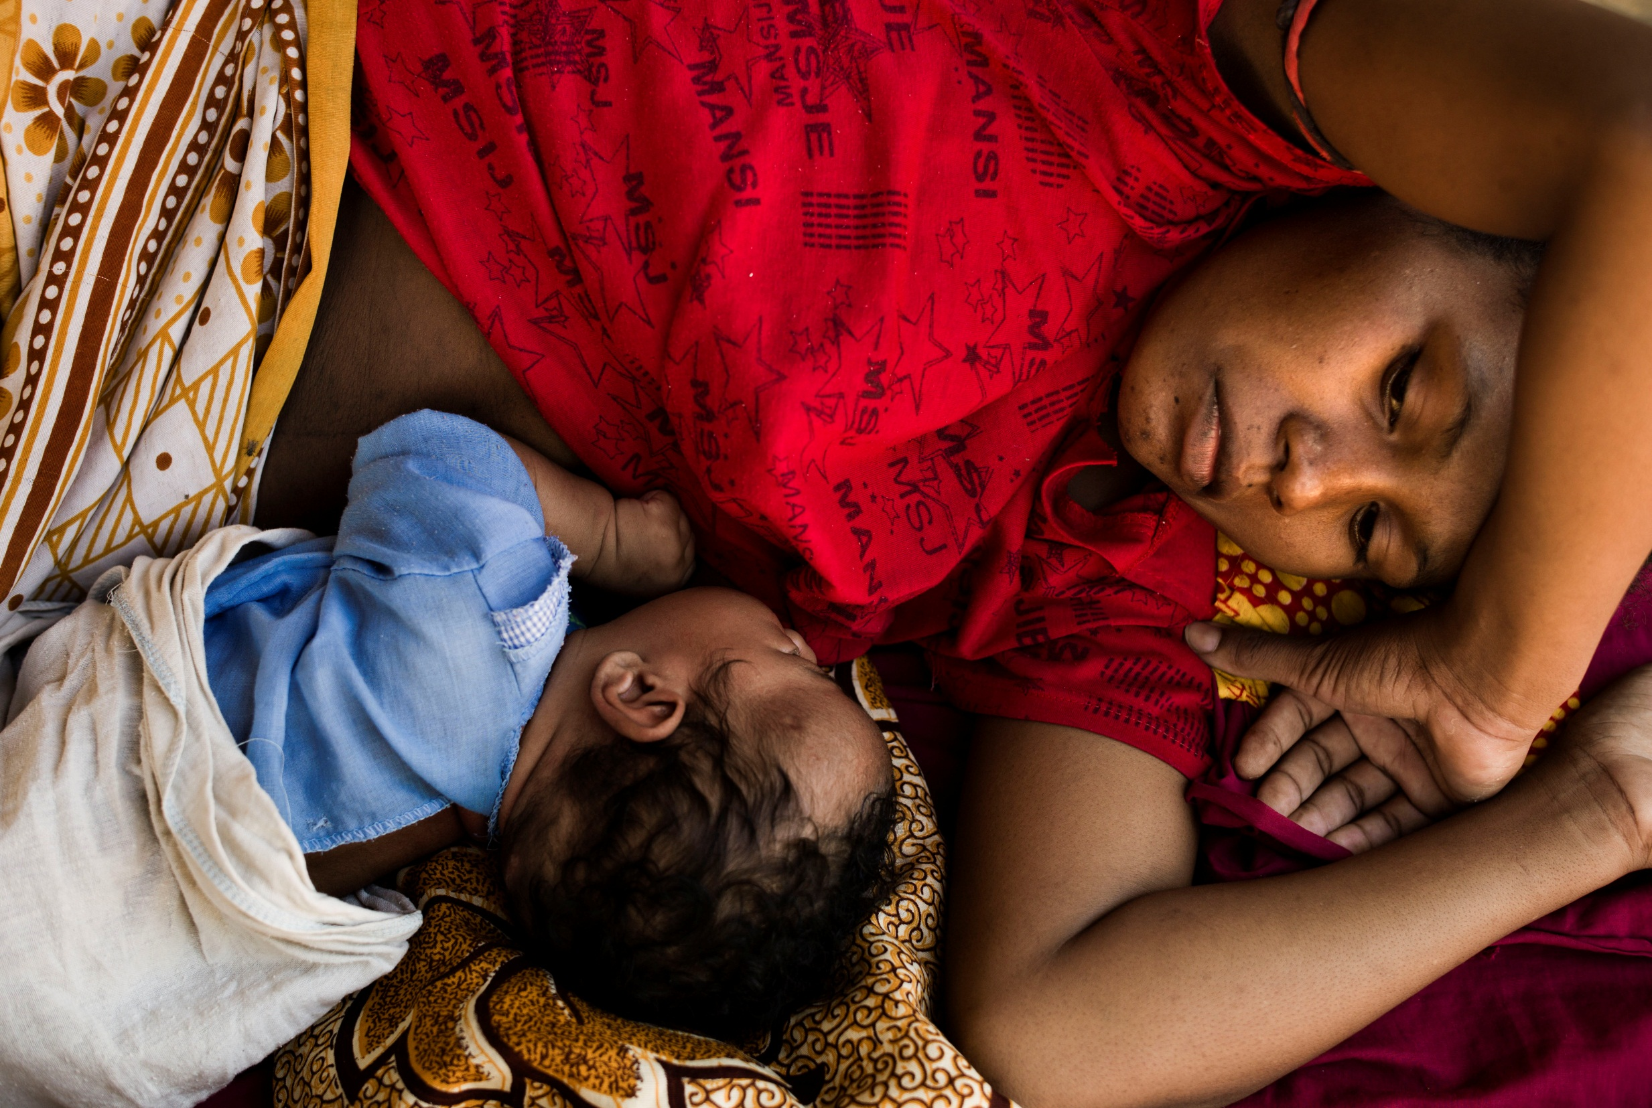
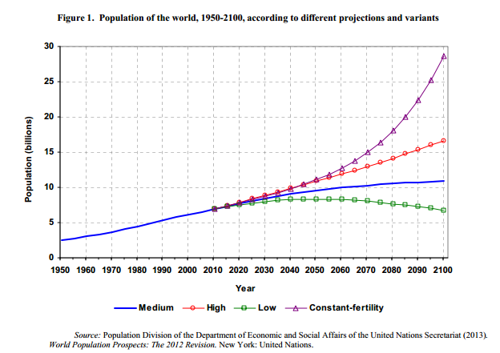

Slide 3
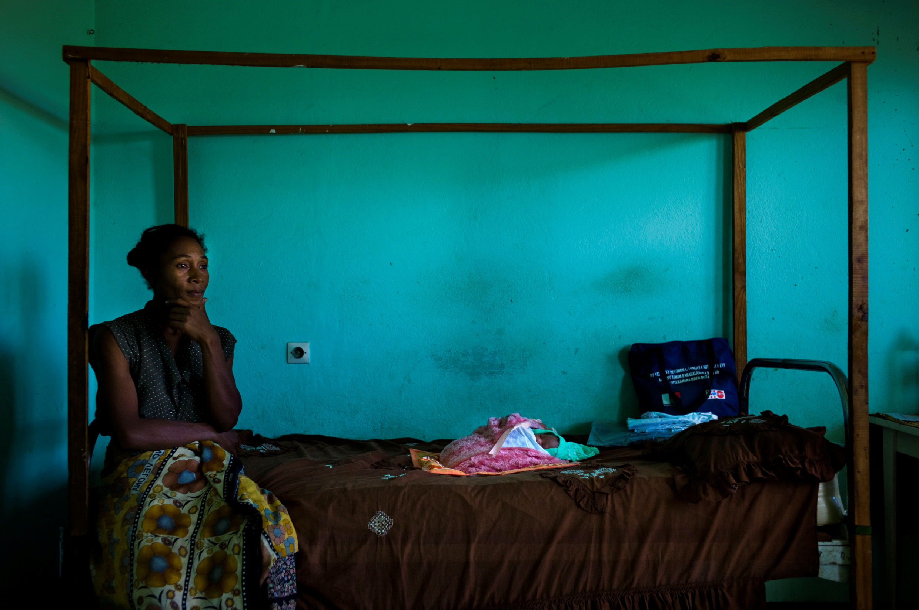
222 million women have an unmet need for contraceptives

Slide 4
800 women die every day due to pregnancy and child birth.
For every maternal death, 20 other women get child birth related injuries or complications

