Slide 1
Supply Division
Presentation for the Danish Society for International Development
3rd October, 2013, Copenhagen

Slide 2
UNICEF
UNICEF, the United Nations Children’s Fund, was founded in 1946 and is the UN Agency for children.
Our global mandate is to realize children’s rights in the area of health, education, and protection.
We are active in more than 190 countries and territories.
We have country offices worldwide, eight regional offices, headquarters in New York, Geneva, and our global supply operation in Copenhagen.

Slide 3
Supply Division UNICEF
UNICEF has been in Copenhagen since 1962.
Supply Division has over 300 national and international staff and is now located in UN City Campus 2.
Copenhagen is home to the world’s largest non-food humanitarian warehouse (20,000 sq m).
Supply Division manages warehouse hubs in Dubai, Panama, Shanghai and Duala

Slide 4
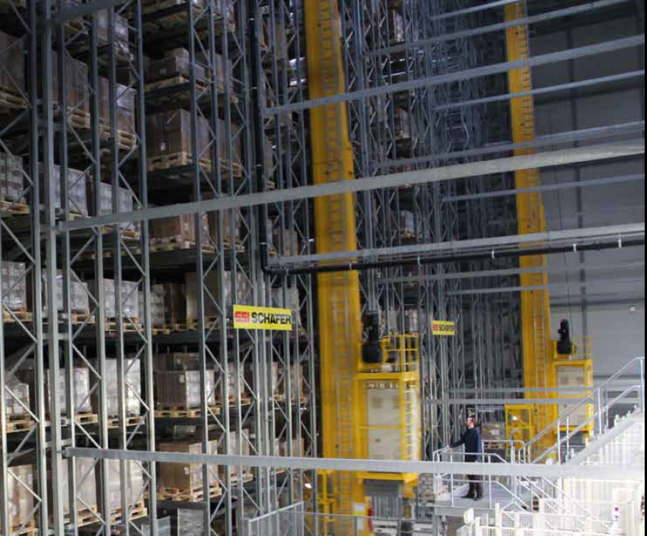
About the Copenhagen warehouse
20,000 m2
850 essential items
36,000 pallet places
30 staff
Largest humanitarian warehouse
Handles 5% of UNICEF’s orders

Slide 5
Critical Functions of Supply Division
Support programmes with an effective, efficient supply operation.
Support response to emergency supply and logistics needs.
Serve as a centre of expertise and knowledge on essential supplies for children and share know-how with others
Provide procurement services to governments and development partners on strategic-essential supplies
Establish policies for supply chain activities and support governments in building capacity of health supply chains.
Lead product innovation

Slide 6
Major commodity groups
2012: $2.468 billion in supplies and services
85% of our procurement is in collaboration with other UN agencies

Slide 7
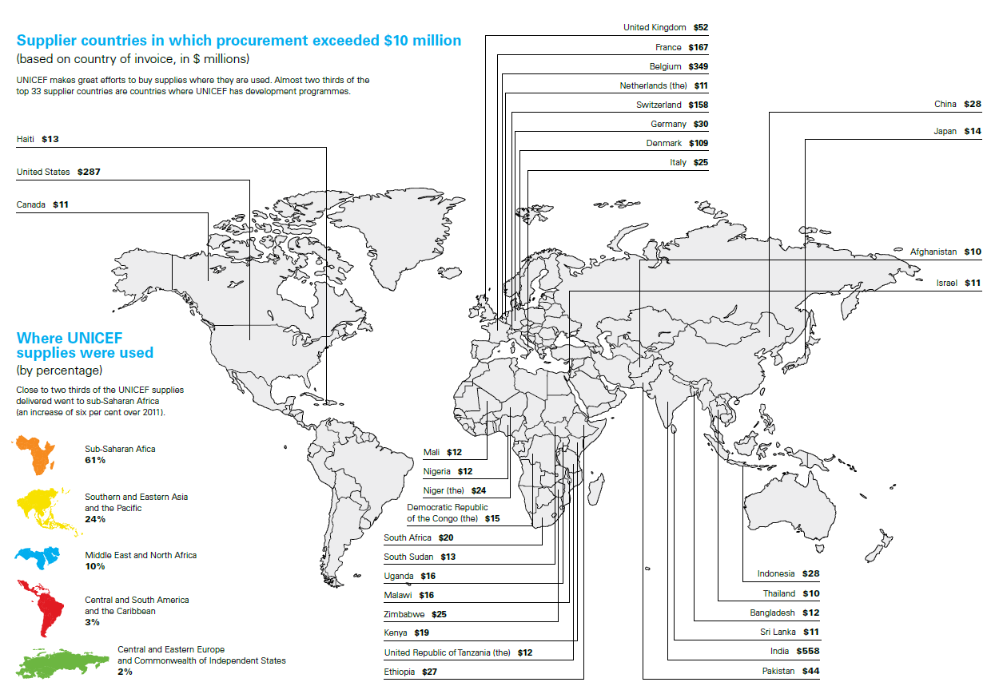
Supplier countries

Slide 8
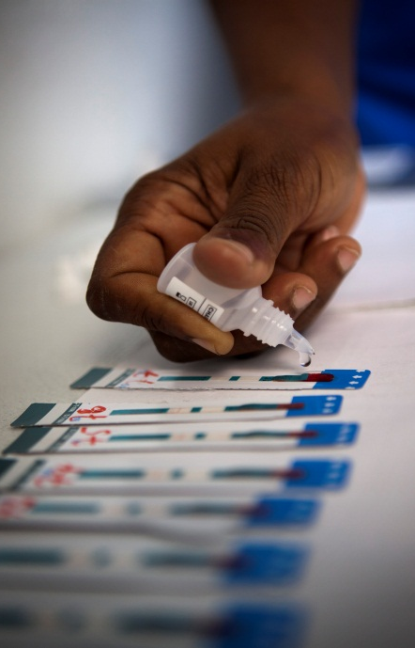
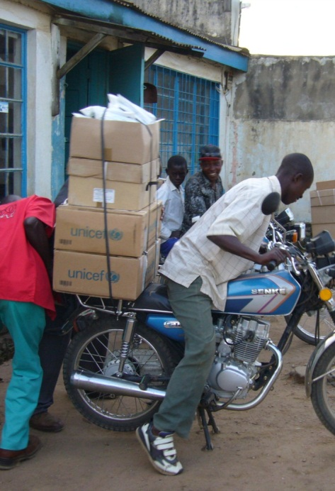
UNICEF: http://www.unicef.org UNICEF Supply: http://www.unicef.org/supply

